Slide 1
Quadrat characteristics

Slide 2
SCBI

Slide 3
30
45
60
2
4
6
8
DBH
Density
0.011
-0.09
0.033
-0.11
60
SoilGWC
.
45
Density
-0.032
0.26
-0.048
30
x
pH
Density
-0.058
-0.034
8
x
6
SIR
4
Density
0.19
2
x
Aspect
Density
x
380
320
x
7.5
6.5
5.5
30
20
10
20
60
120
5.0
6.5

Slide 4
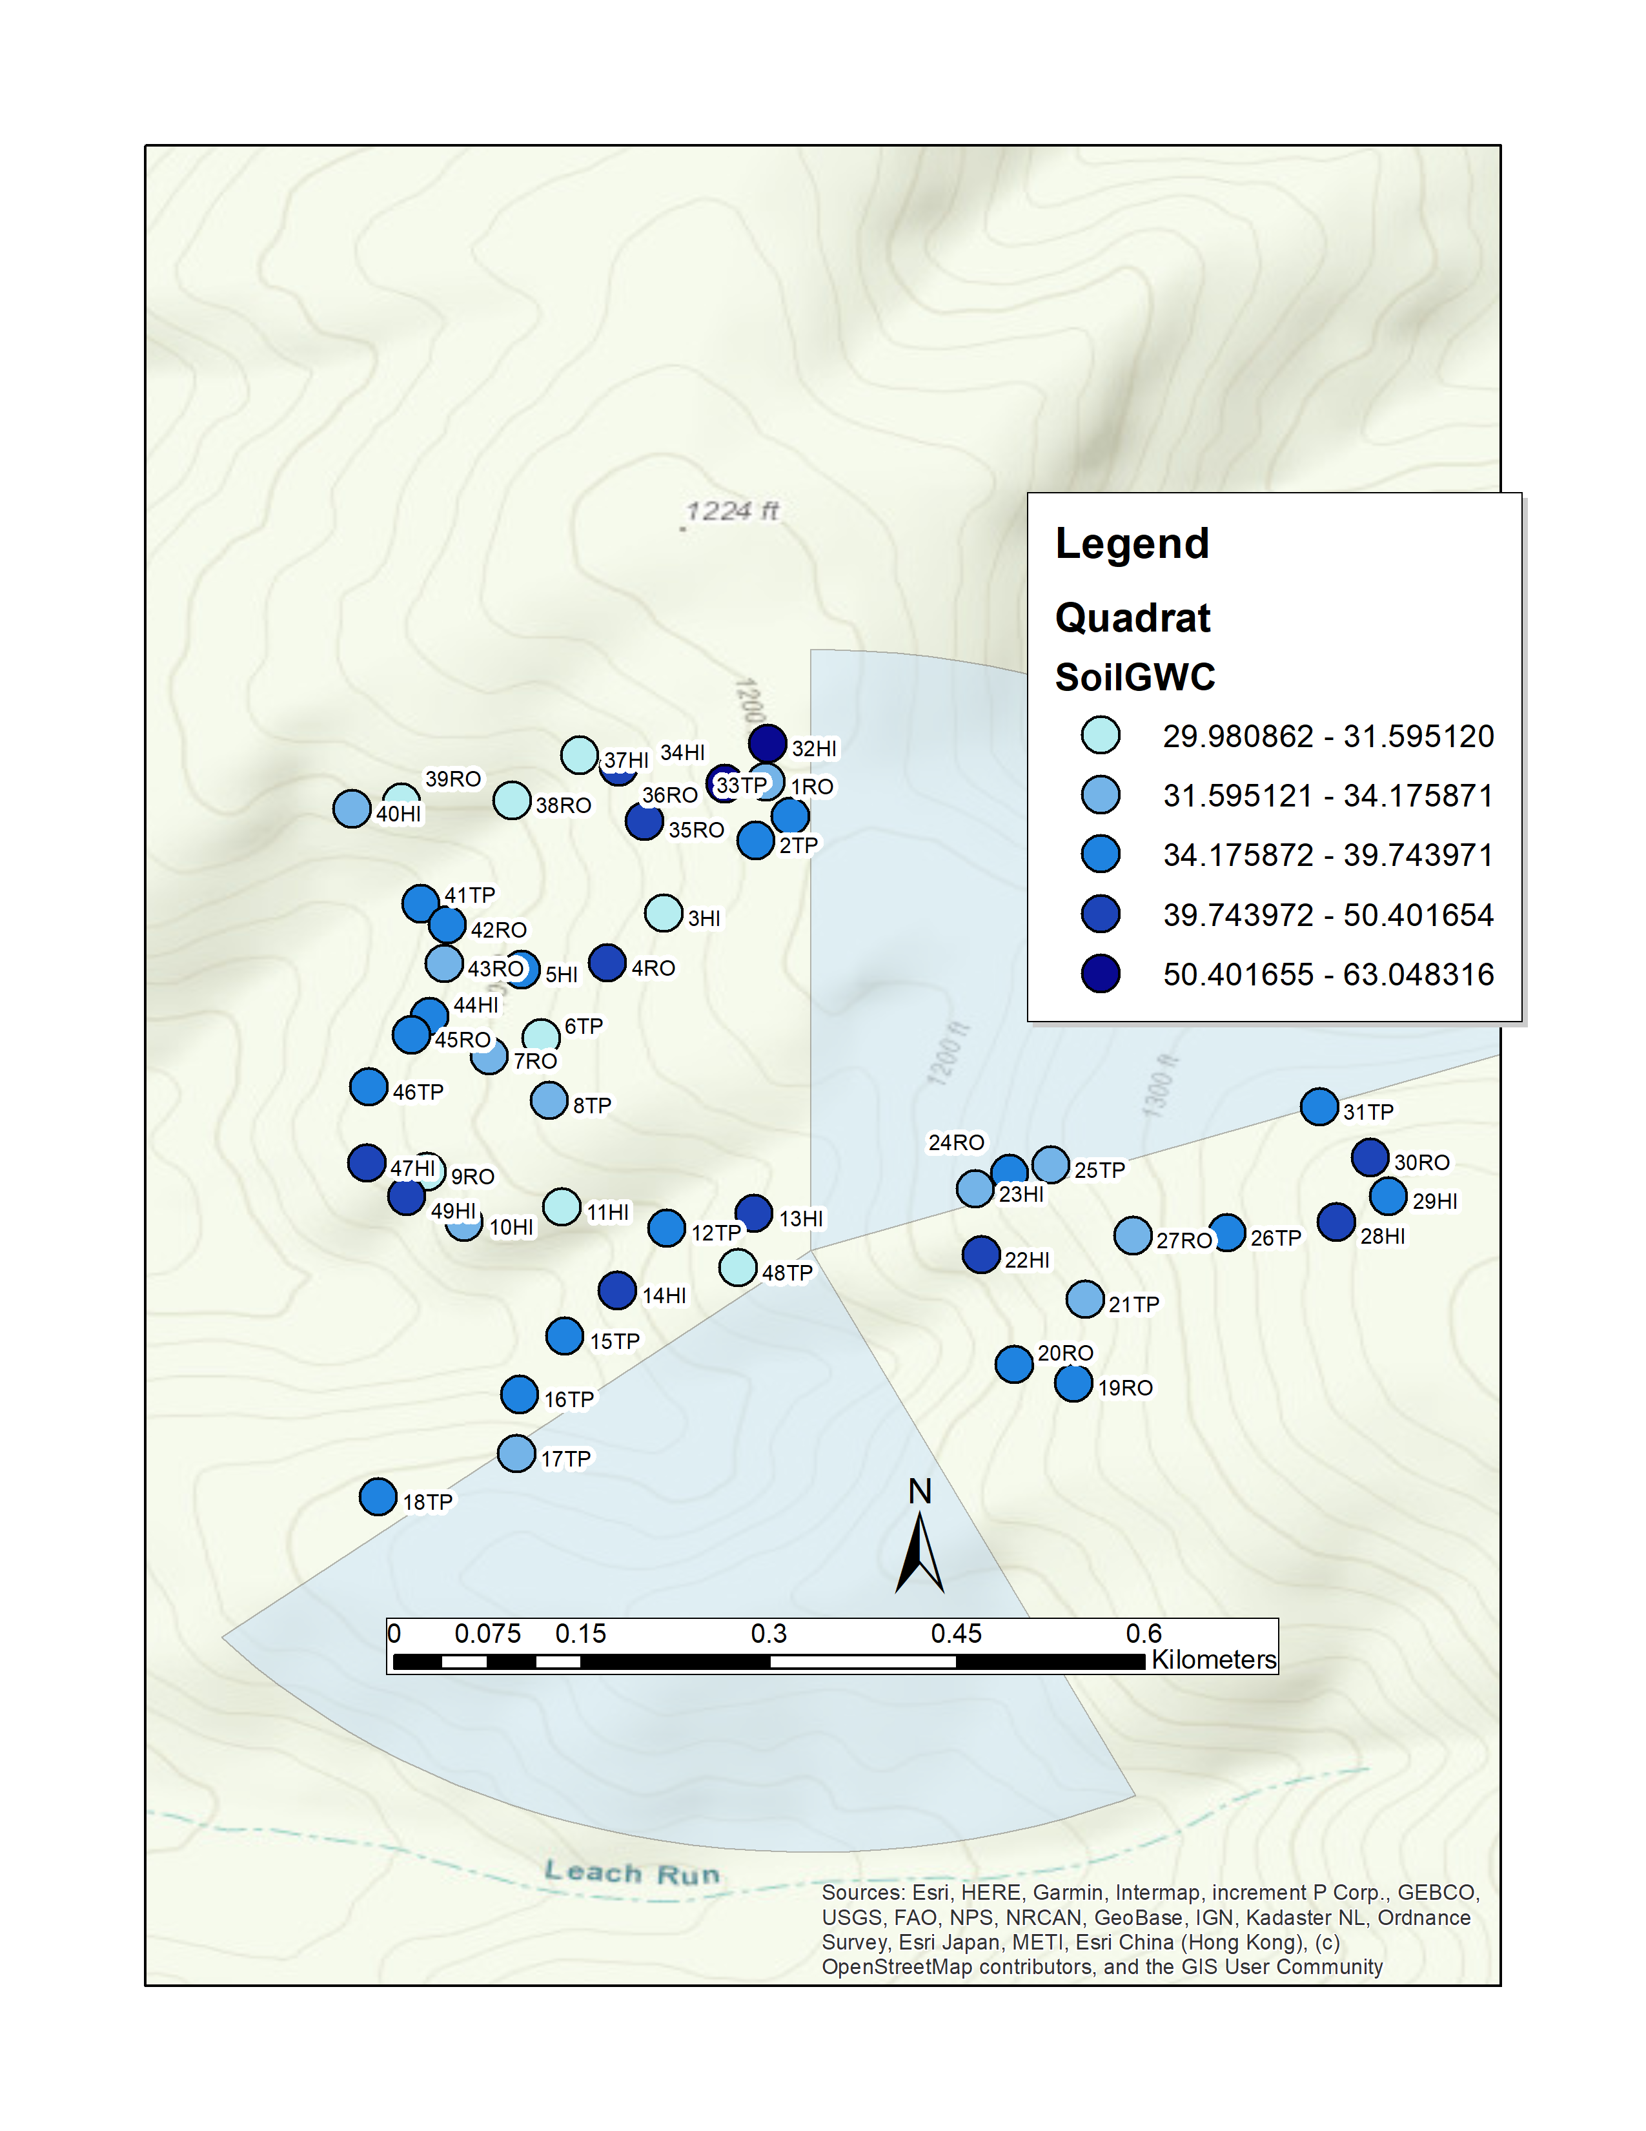
Figure 2: SCBI Soil Moisture (% GWC)

Slide 5
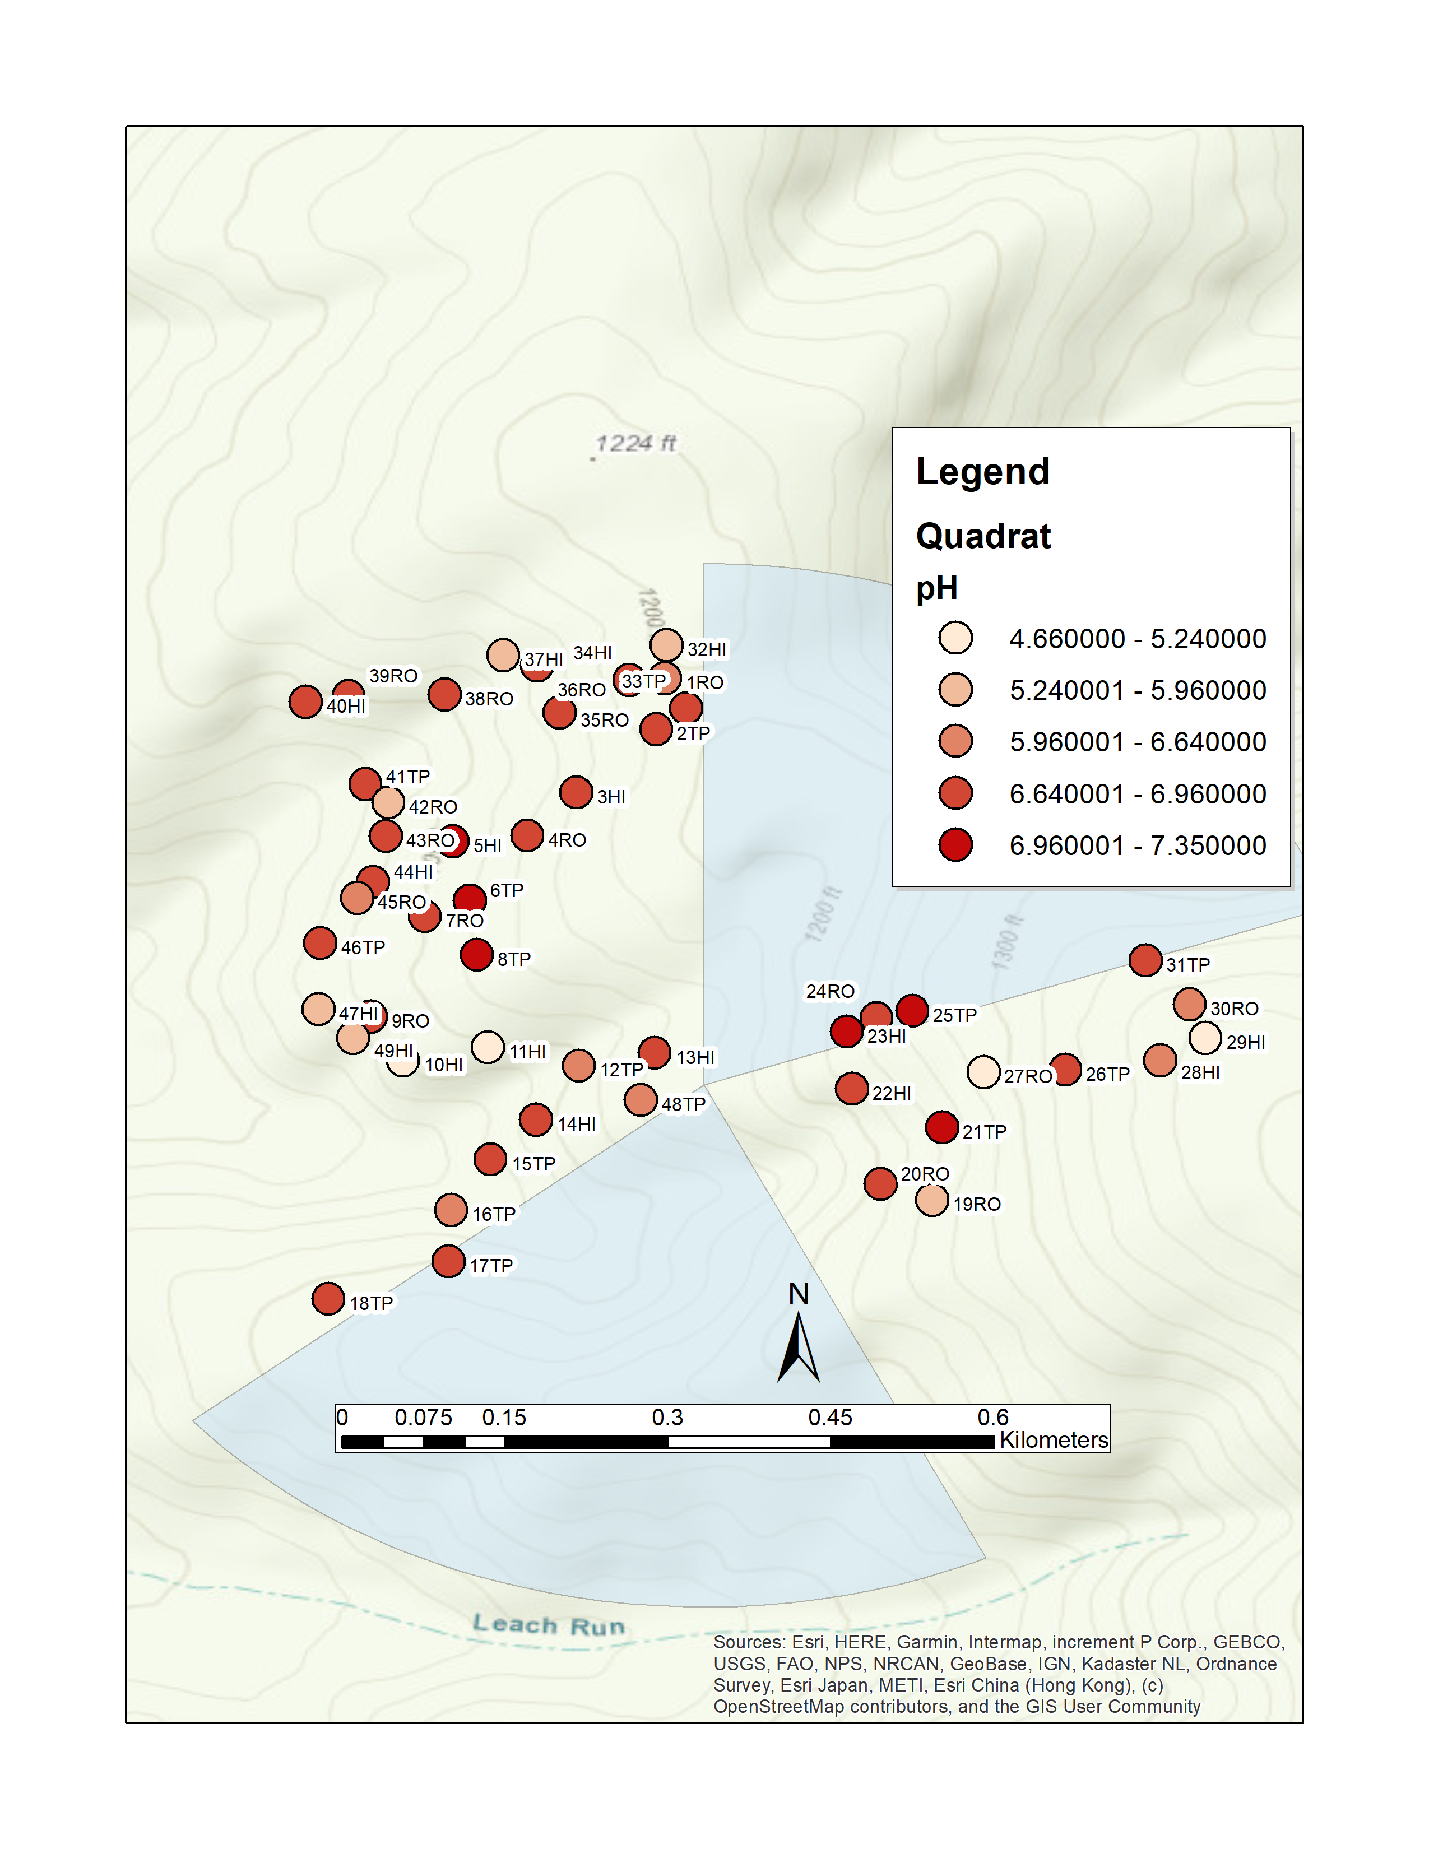
Figure 3: SCBI soil pH

Slide 6
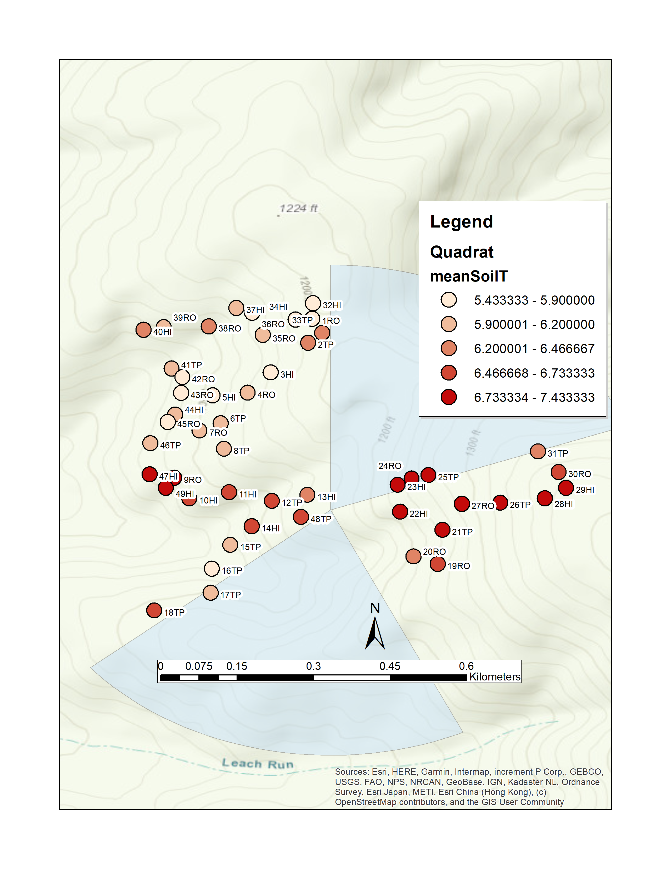
Figure 4: SCBI soil temperature (1/15/2020)

Slide 7
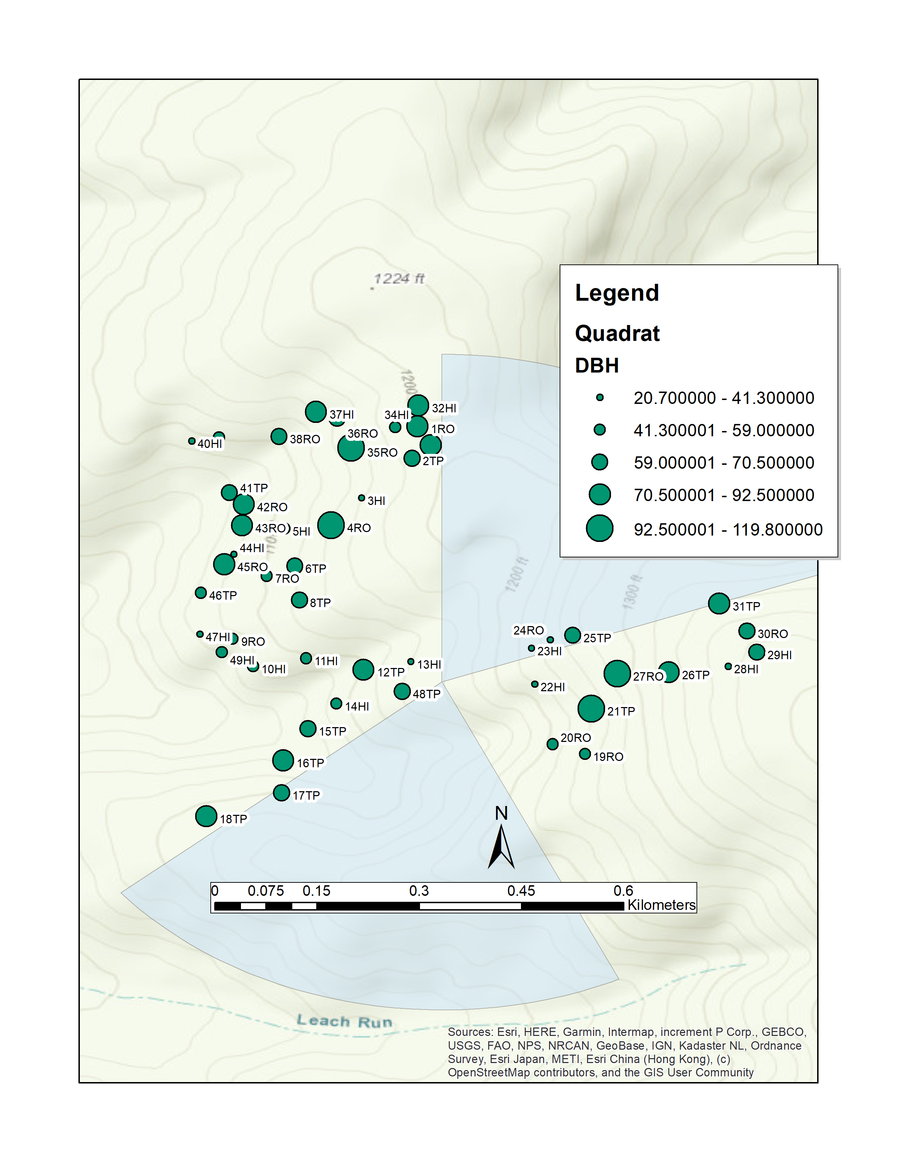
Figure 5: SCBI canopy tree DBH

Slide 8
HARV

Slide 9
50
70
90
4
6
8
5
15
0.0
1.5
3.0
DBH
.
Density
0.037
-0.18
-0.17
0.21
0.11
0.33
0.22
-0.014
90
SoilGWC
.
70
Density
-0.18
0.11
-0.33
-0.30
0.10
-0.03
0.30
50
x
pH
***
***
*
Density
0.23
0.0012
0.22
-0.62
-0.60
0.39
x
8
SIR
6
Density
-0.28
-0.27
-0.066
-0.0092
0.36
*
4
x
Aspect
.
***
Density
0.60
0.15
0.014
-0.31
x
15
Elevation
Density
-0.083
-0.24
-0.21
5
x
Slope
.
0.83
Density
***
-0.33
x
3.0
meanSoilT
1.5
Density
-0.27
0.0
x
Density
x
70
40
10
x
20
50
80
3.9
4.2
340
360
1
3

Slide 10
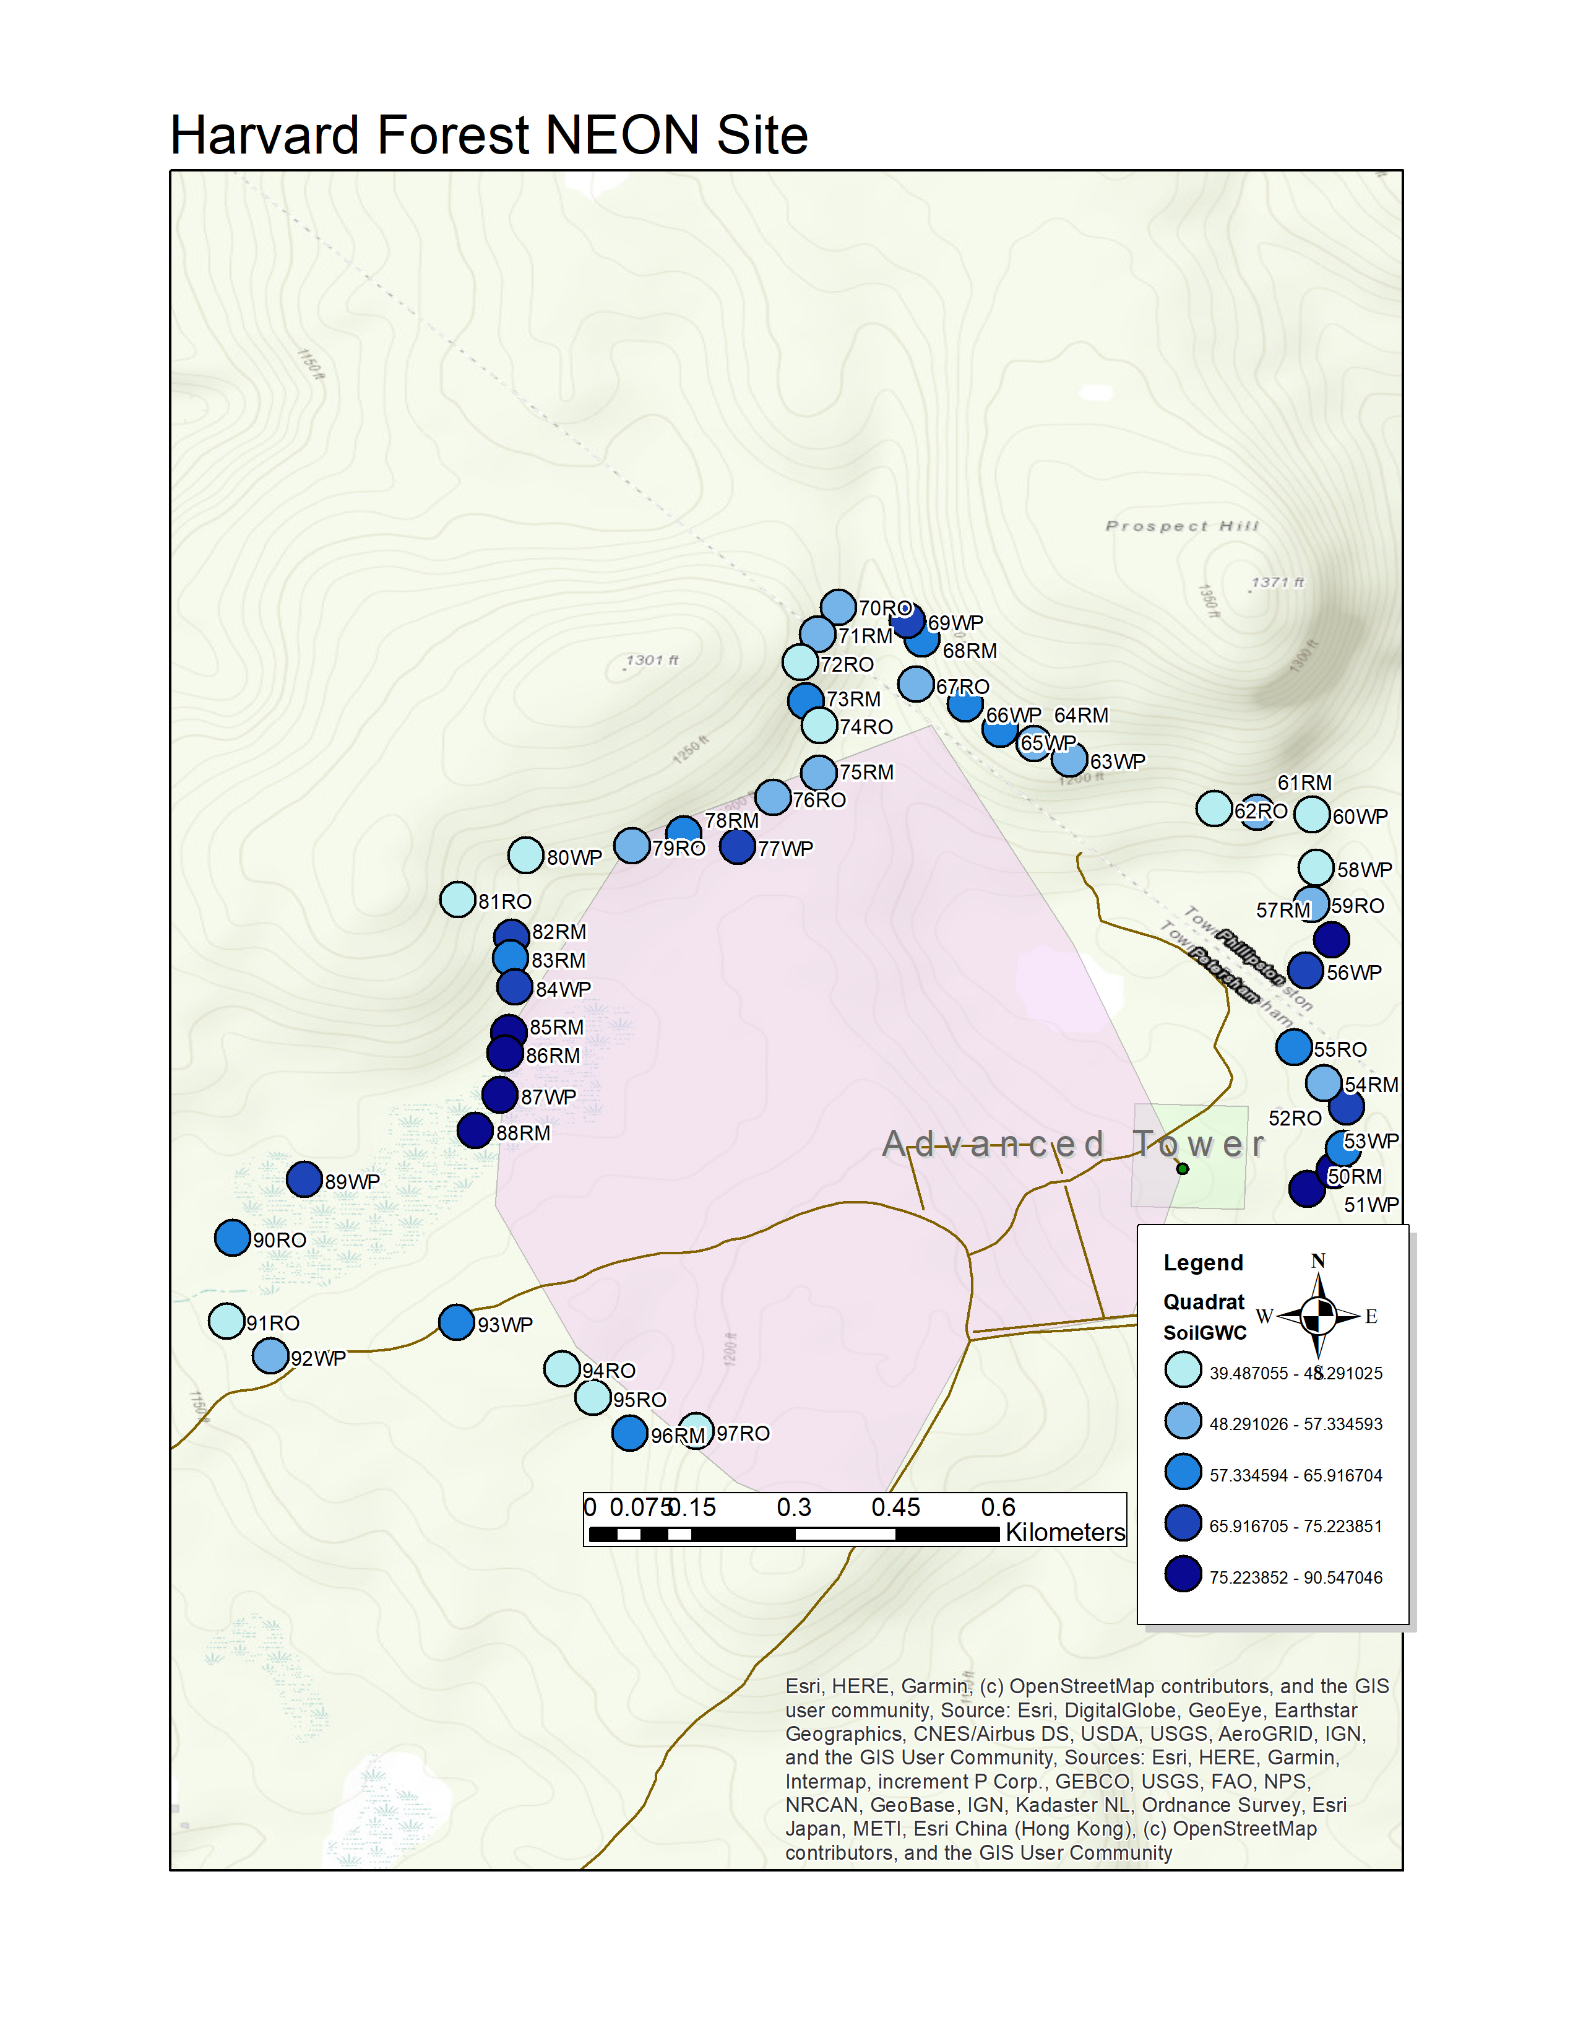
Figure 7: HARV Soil Moisture (% GWC)

Slide 11
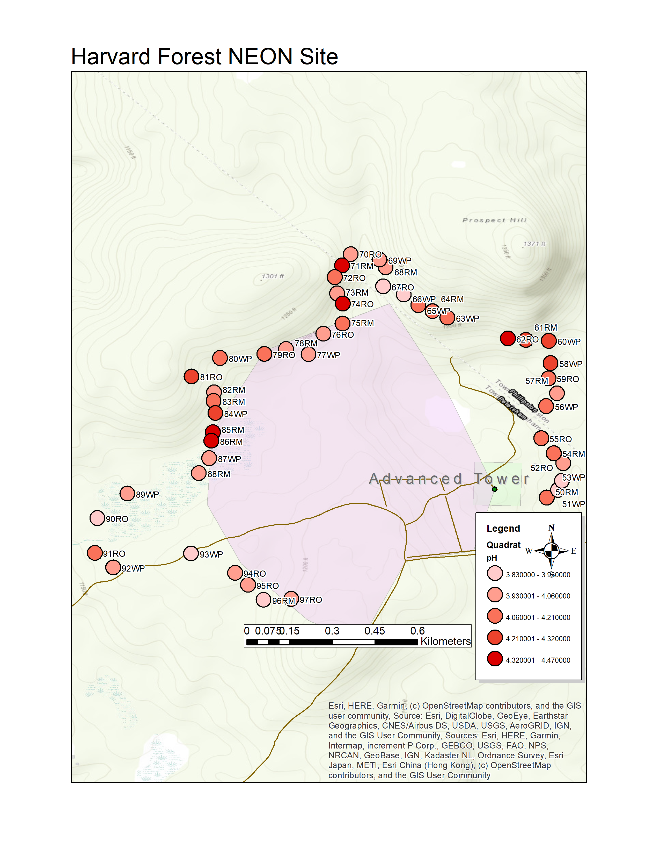
Figure 8: HARV soil pH

Slide 12
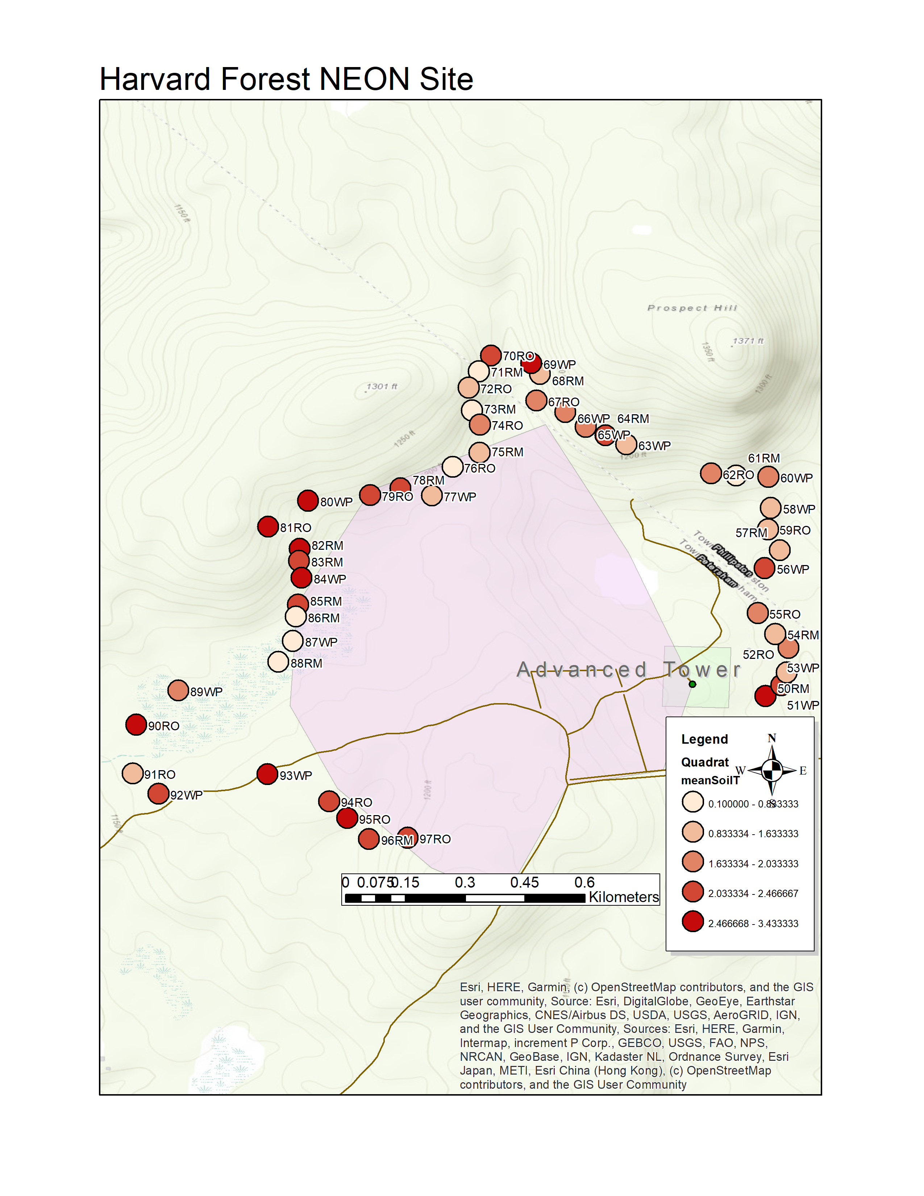
Figure 9: HARV soil temperature (12/10/2020)

Slide 13
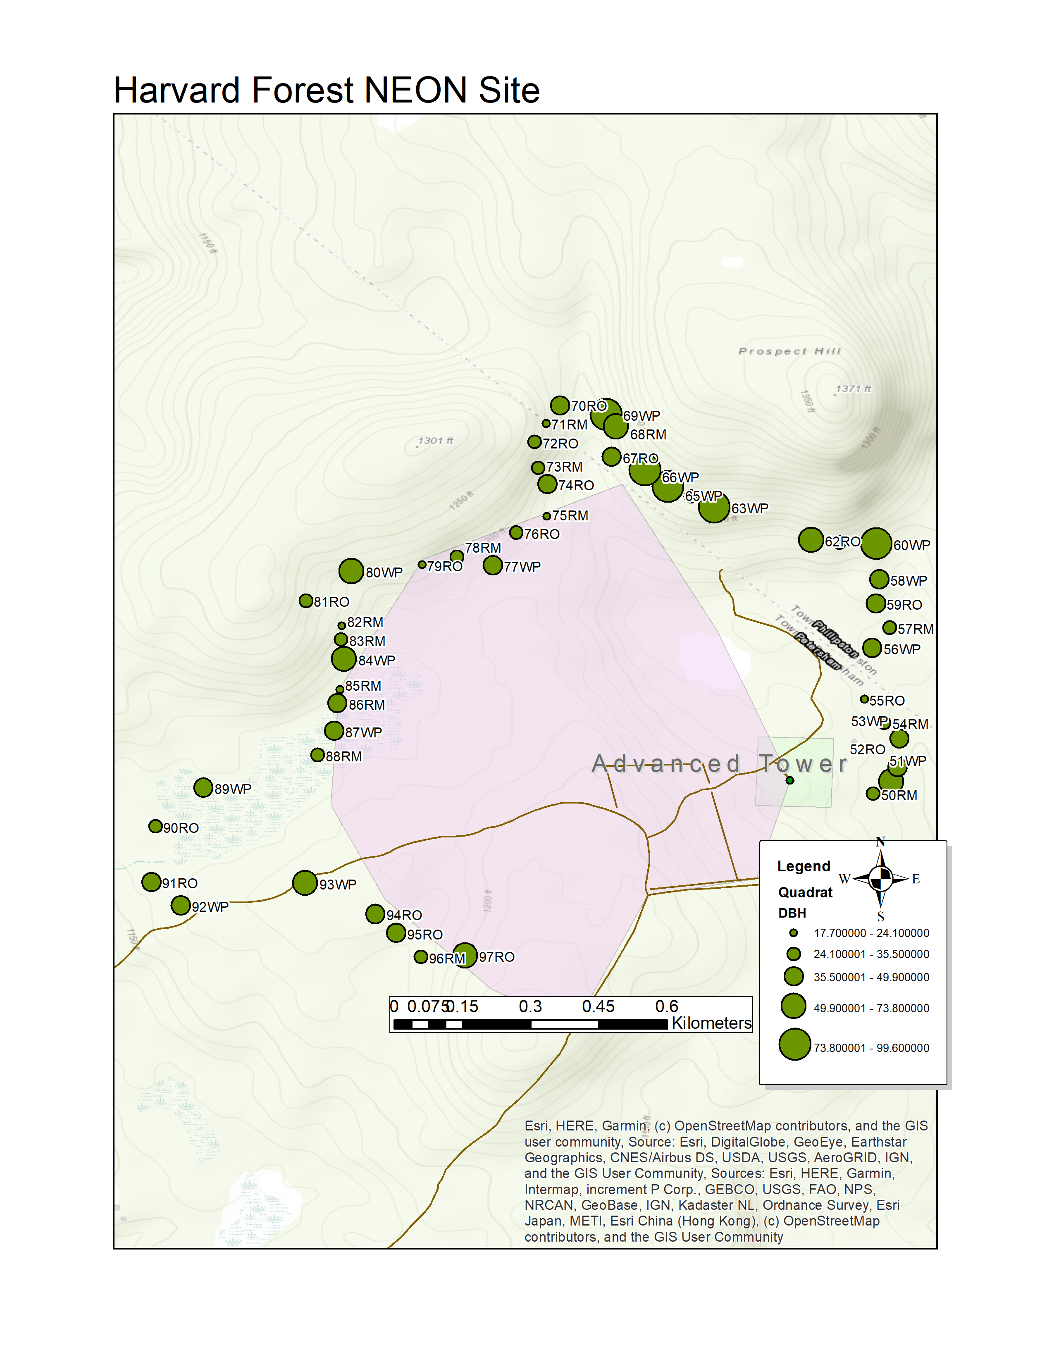
Figure 10: HARV canopy tree DBH

Slide 14
Selected soils for microcosms

Slide 15
Figure 11: Soil Moisture (GWC) histogram by species, highlighting selected microcosms.
Subset of quadrats for microcosm experiement
Dashed are the subset used for microcosm.
8
6
4
HI
2
0
8
6
4
RM
2
0
8
6
Site
count
RO
HARV
4
2
SCBI
0
8
6
4
TP
2
0
8
6
4
WP
2
0
40
60
80
SoilGWC
Notes:
Ones in dashed lines and transparent white are selected for microcosms.

Slide 16
Figure 12: pH histogram by species, highlighting selected microcosms.
Subset of quadrats for microcosm experiment
6
4
HI
2
0
6
4
RM
2
0
6
4
Site
count
RO
HARV
2
SCBI
0
6
4
TP
2
0
6
4
WP
2
0
4
5
pH
6
7

Slide 17
Figure 13: SIR histogram by species, highlighting selected microcosms
.
Subset of quadrats for microcosm experiement
Dashed are the subset used for microcosm.
3
2
HI
1
0
3
2
RM
1
0
3
2
Site
count
RO
HARV
1
SCBI
0
3
2
TP
1
0
3
2
WP
1
0
2
4
6
8
SIR

Slide 18
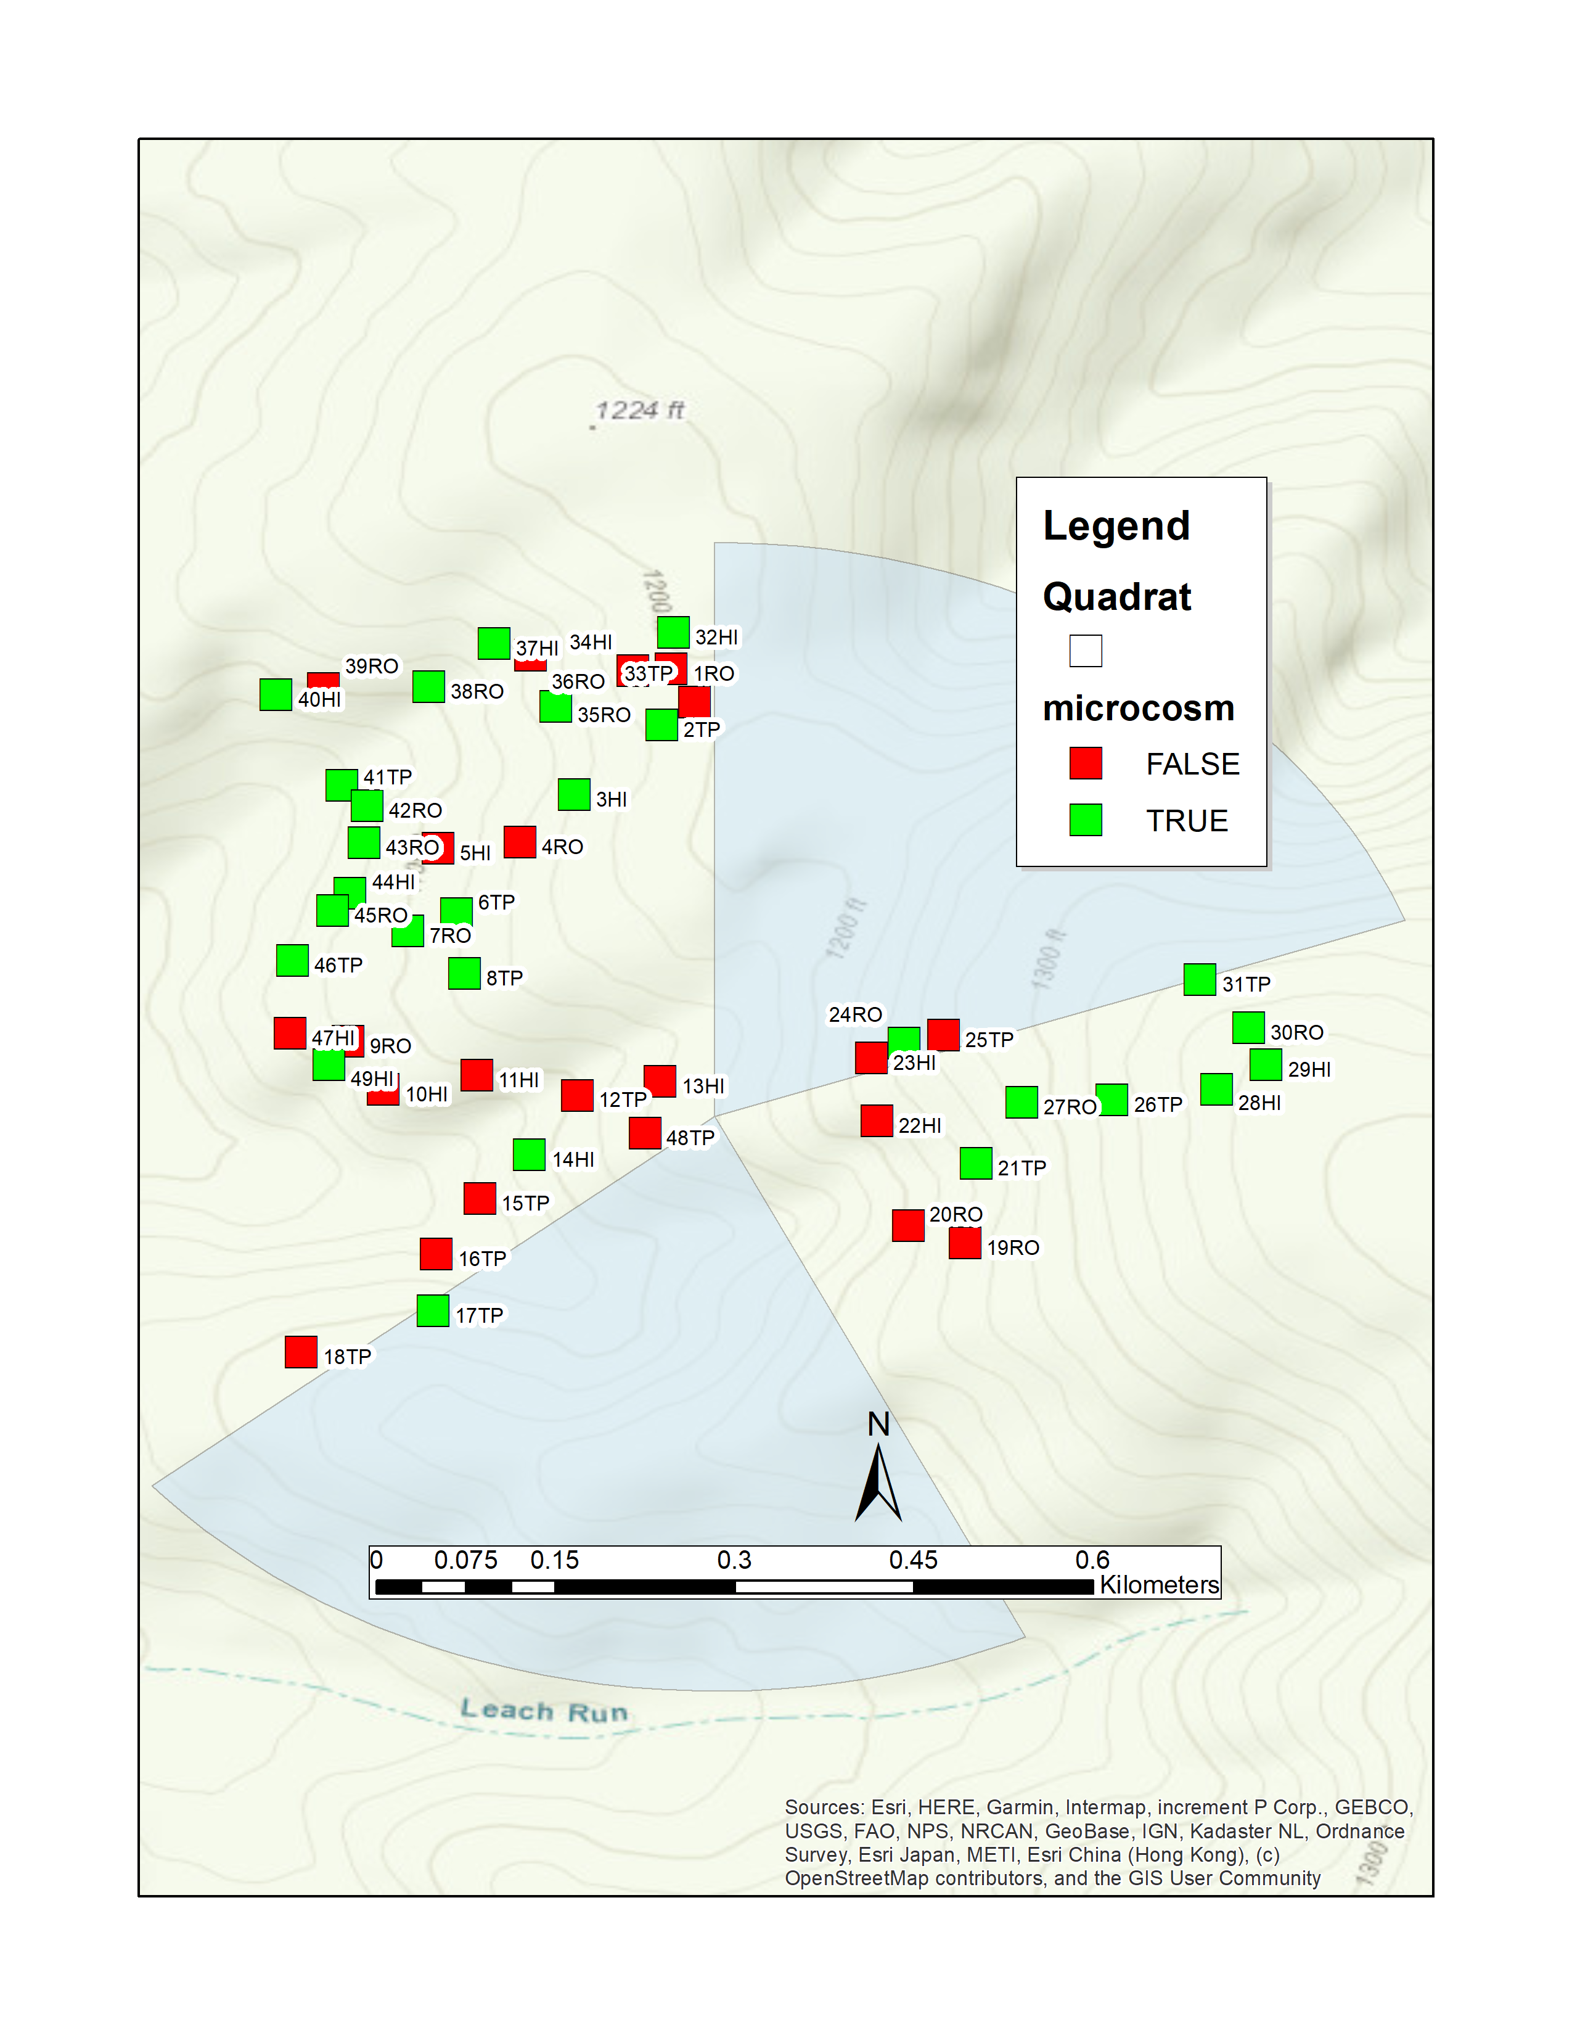
Figure 14: SCBI canopy tree DBH

Slide 19
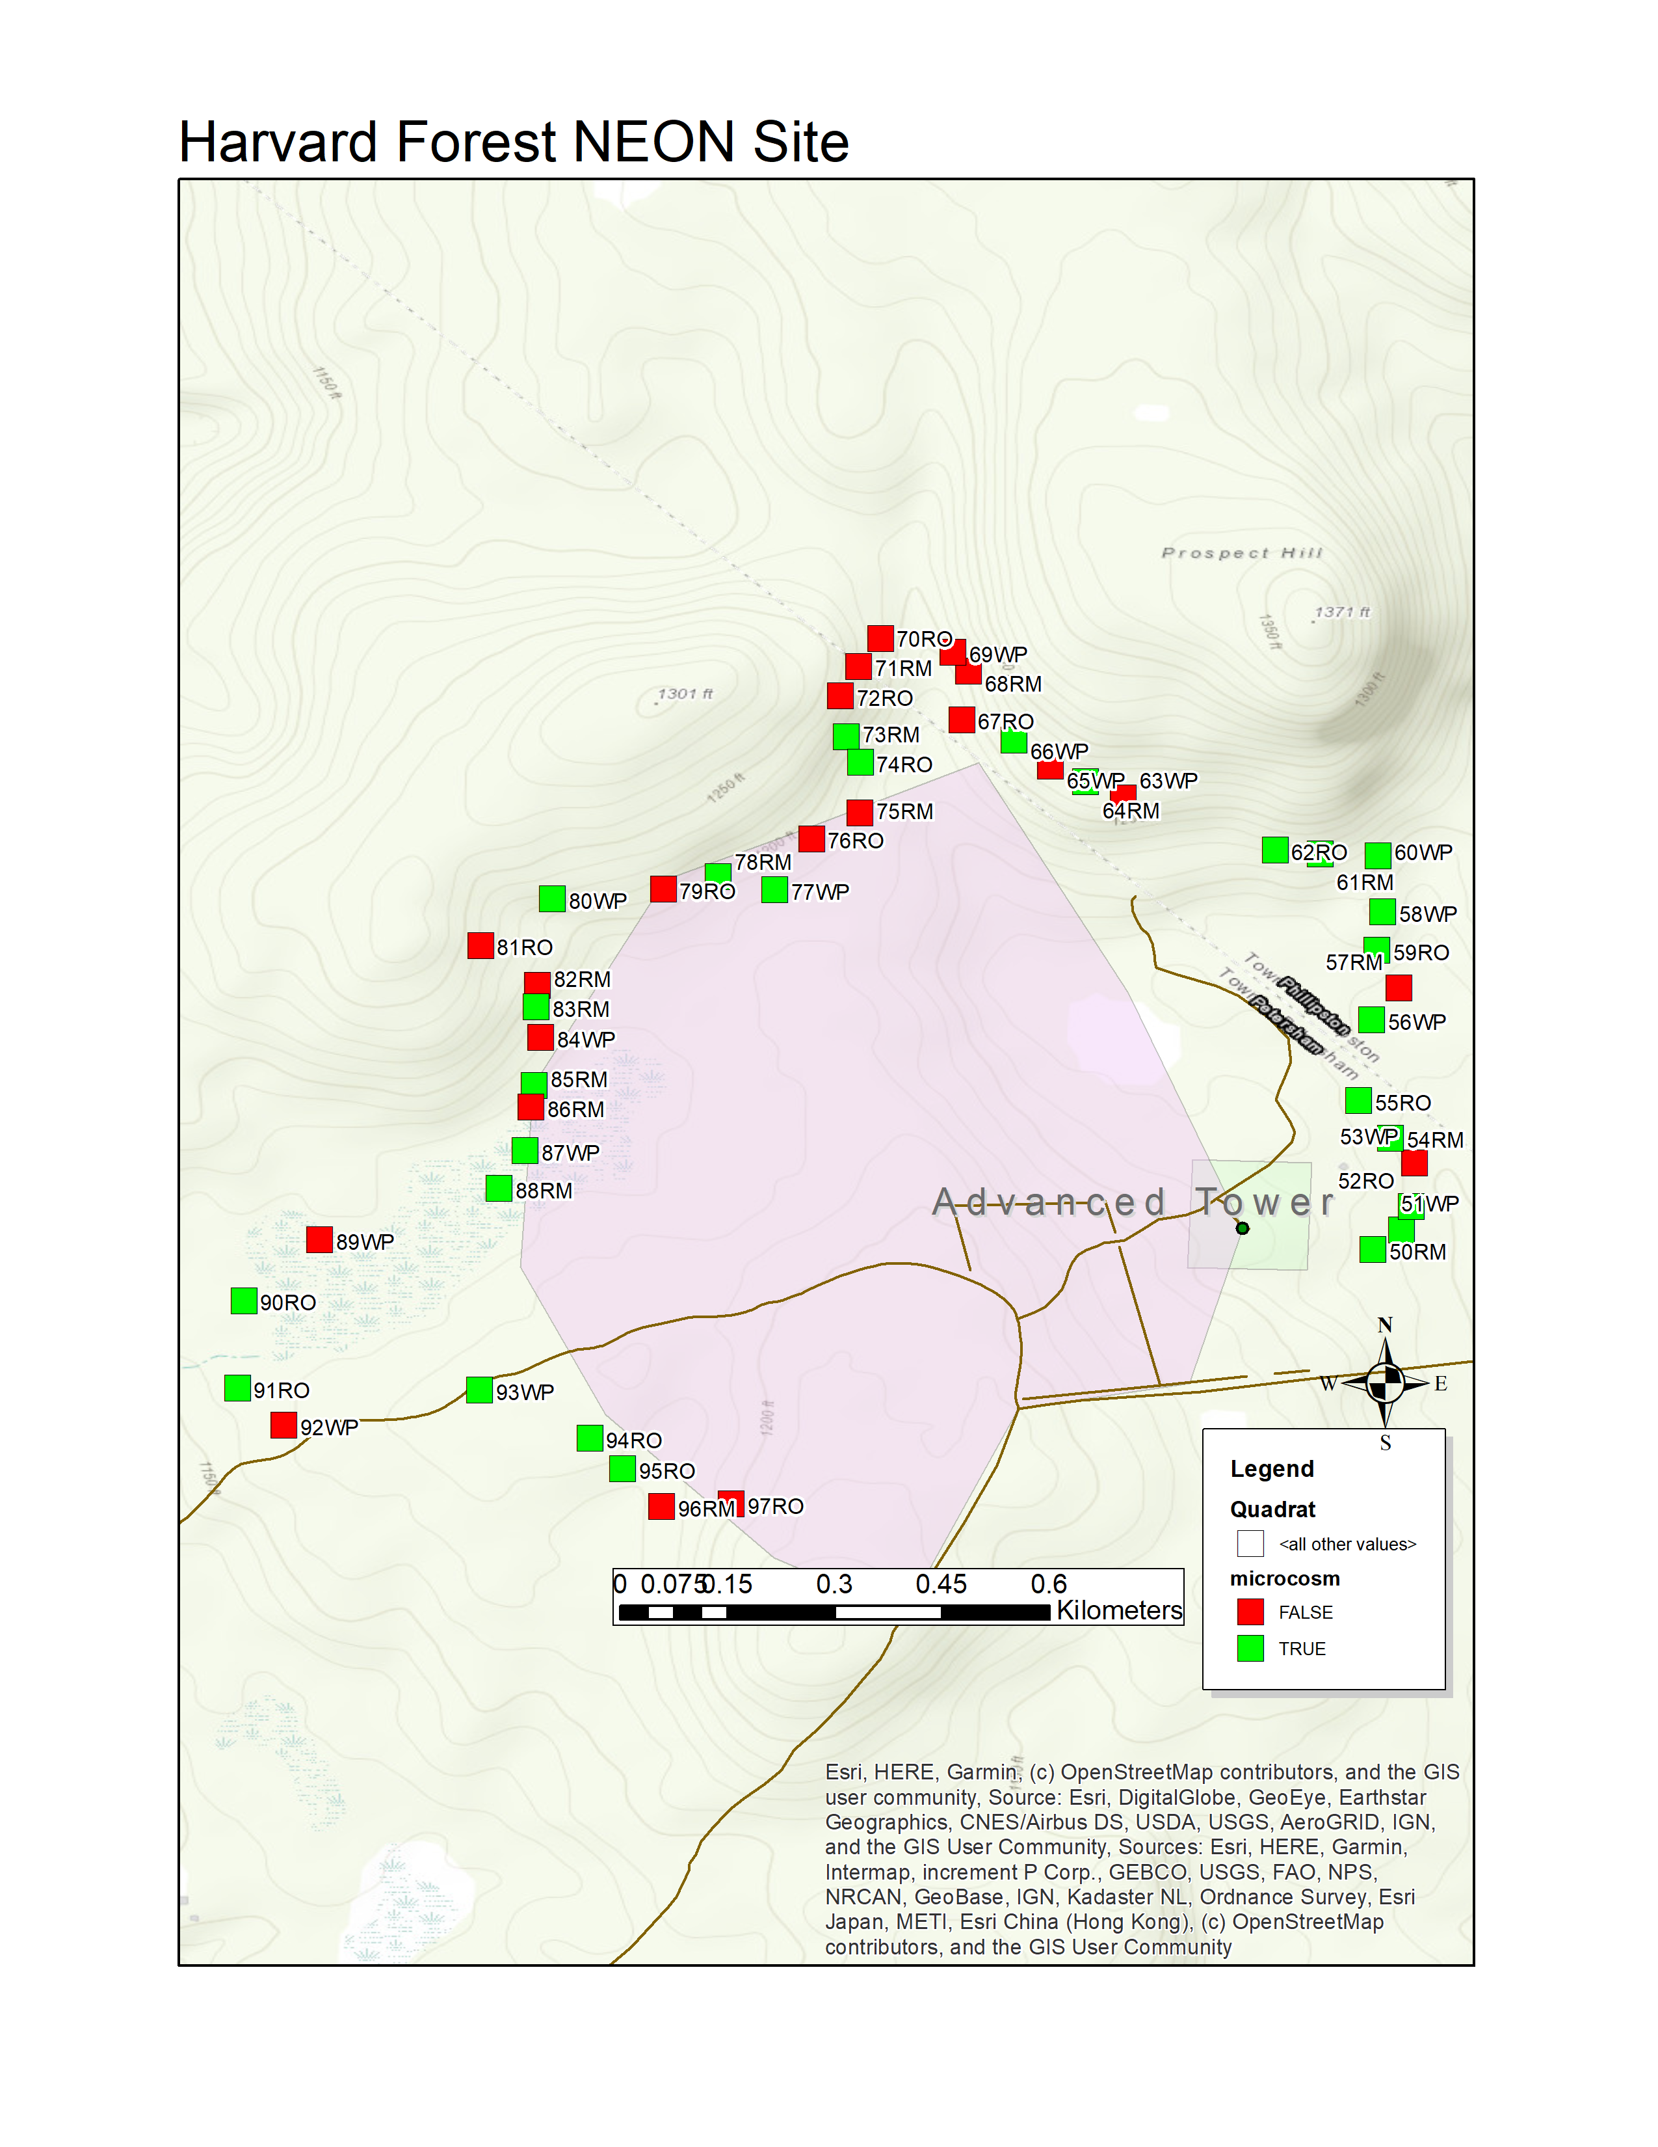
Figure 15: SCBI canopy tree DBH

Slide 20
Figure 16: SCBI PCA of quadrat characteristics
-1.0
-0.5
0.0
0.5
2
50
51
SoilGWC
meanSoilT
57
Slope
0.5
1
55
93
SIR
53
90
95
86
meanLitT
96
meanSoilM
54
69
0
94
70
DBH
0.0
59
91
60
75
79
67
80
66
Comp.2 (17.6% proportion of variance)
58
-1
pH
61
62
72
63
-0.5
74
Aspect
73
-2
71
Elevation
-1.0
-3
-3
-2
-1
0
1
2
Comp.1 (23.7% proportion of variance)
Notes:
I realize variables including aspect may not be relevant, but I just threw this together and will revise it likely.

Slide 21
Figure 17: SCBI PCA of quadrat characteristics
-0.5
0.0
0.5
2
meanSoilM
17
0.5
38
pH
39
1
15
16
1
3
5
31
37
42
Slope
7
2
40
6
25
9
41
43
21
18
DBH
0
24
12
45
0.0
Comp.2 (22.8% proportion of variance)
23
48
4
26
49
20
44
46
11
13
10
14
30
Aspect
36
-1
meanLitT
22
19
meanSoilT
27
28
47
35
Elevation
32
-0.5
SIR
34
-2
SoilGWC
29
-2
-1
0
1
2
Comp.1 (33.9% proportion of variance)

